Slide 1
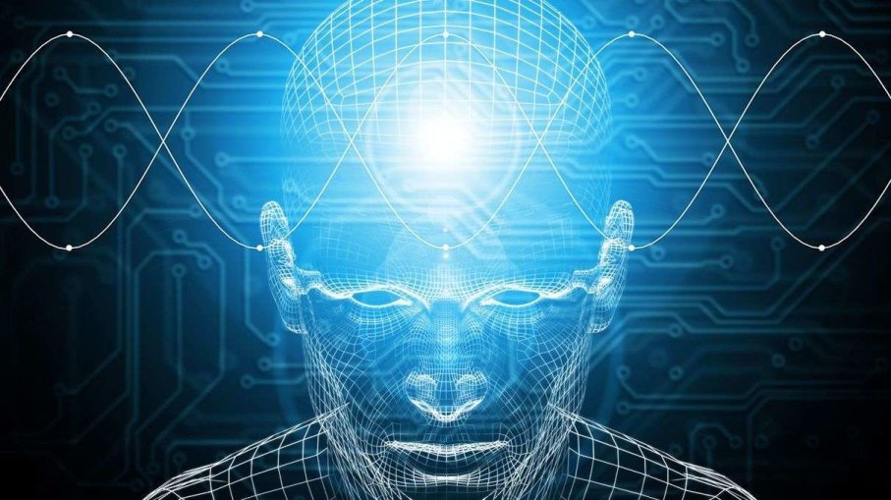
Artificial Intelligence and Data Science
人工智能和数据科学

Slide 2
作者简介：
姓名：王冲野
部门：公安事业部资源服务组
出生日期：1998-08-20
学校：现就读于美国伊利诺伊大学香槟分校
专业：计算机&统计
研究领域：人工智能, 机器学习, 文本挖掘, 推荐系统, 数值分析
邮箱：wangchongye@hikvision.com.cn wangchongye@126.com

Slide 3
Why?

Slide 4
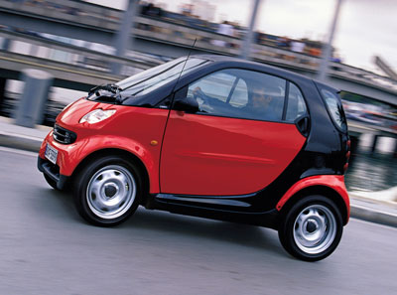

Slide 5
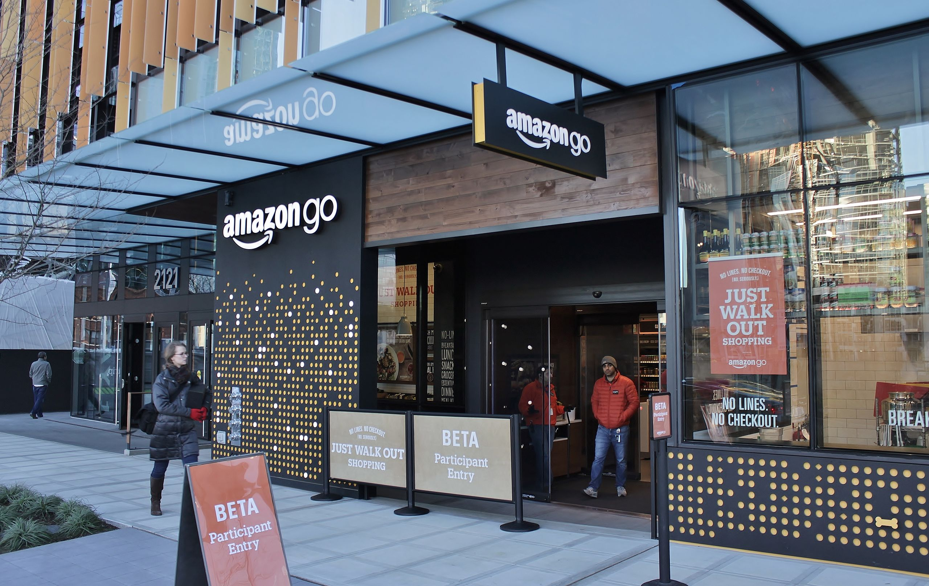

Slide 6


Slide 7
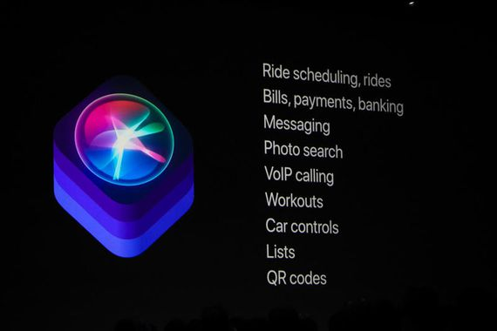

Slide 8
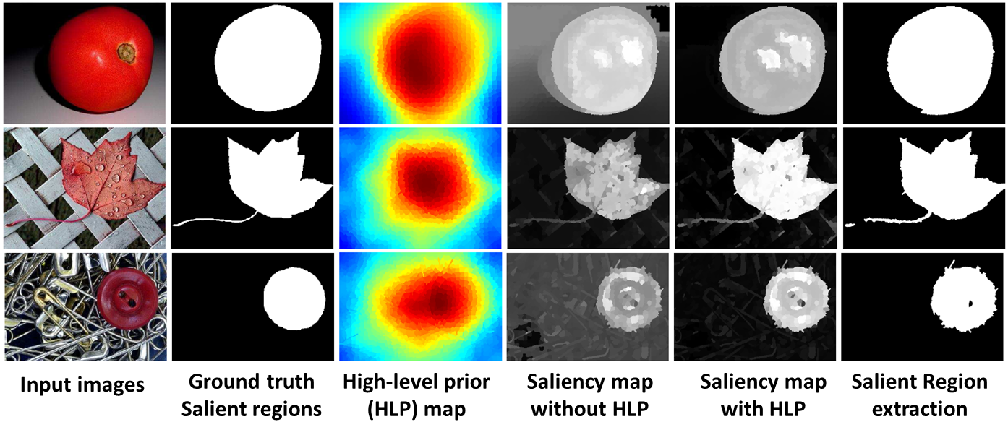

Slide 9
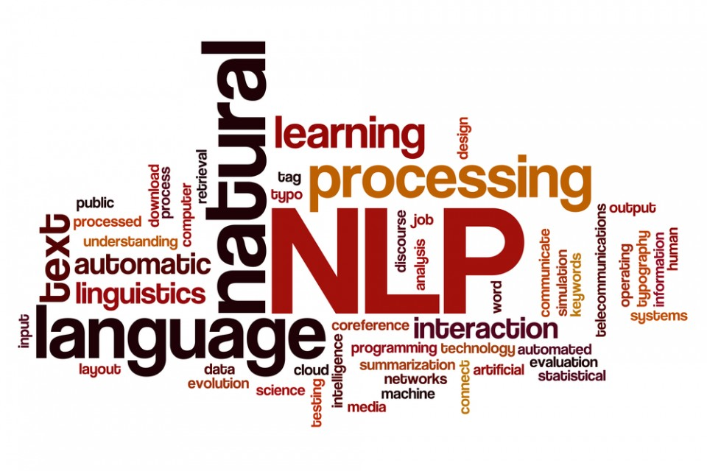
Natural Language Processing
自然语言处理

Slide 10
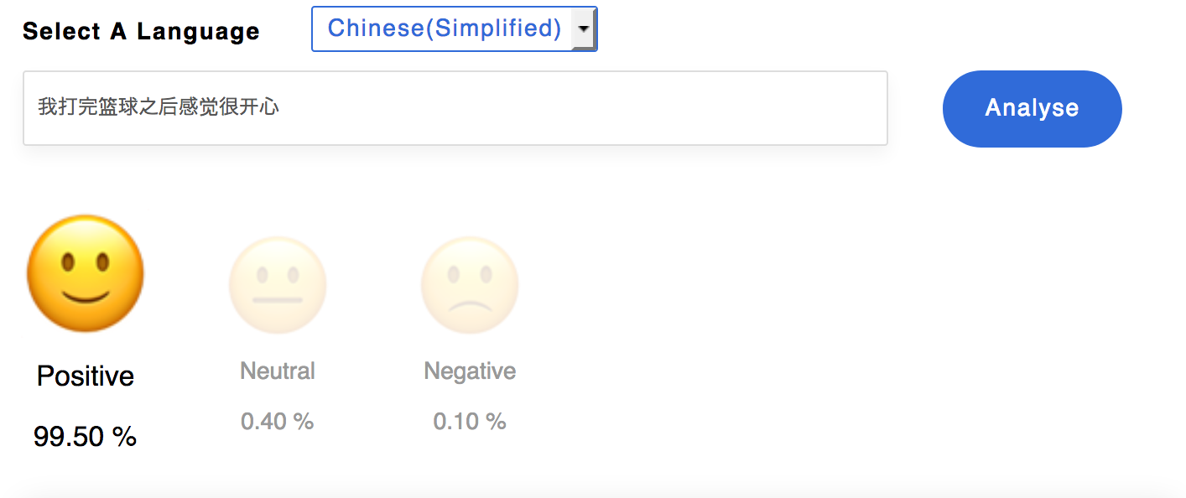

Slide 11
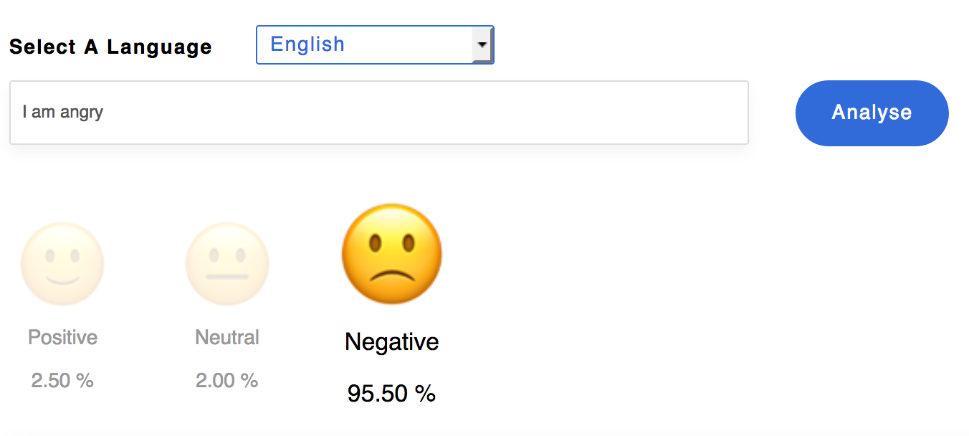

Slide 12
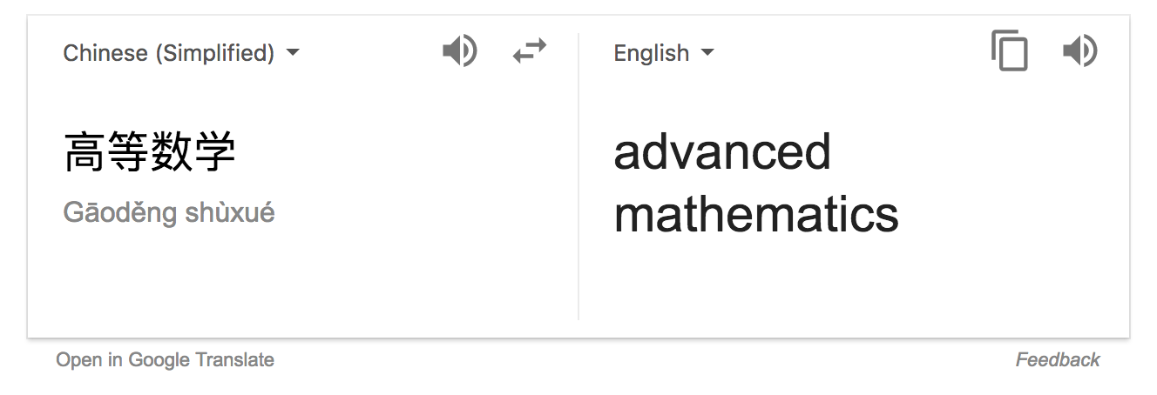

Slide 13
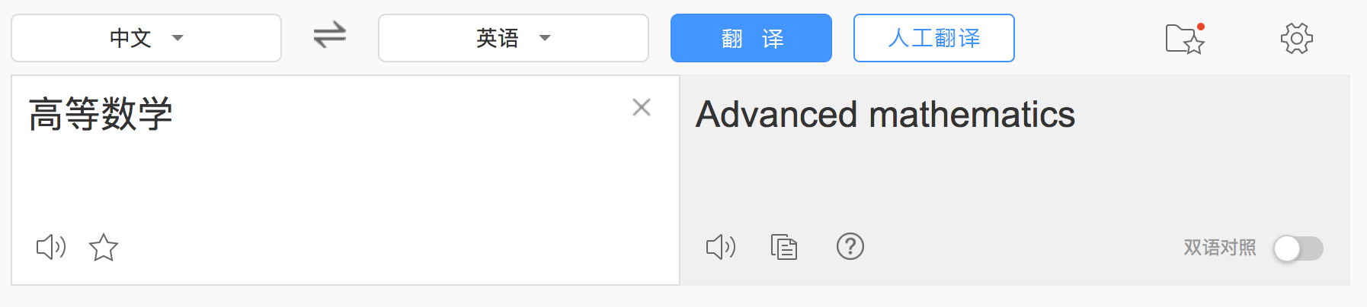

Slide 14
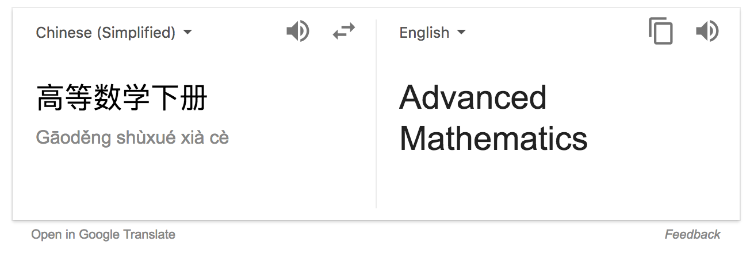

Slide 15
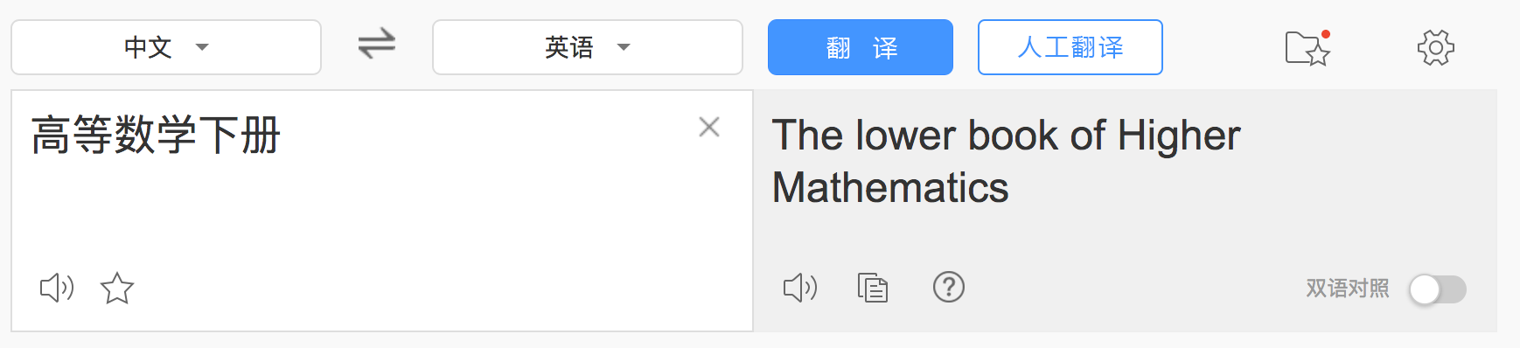

Slide 16

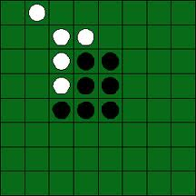
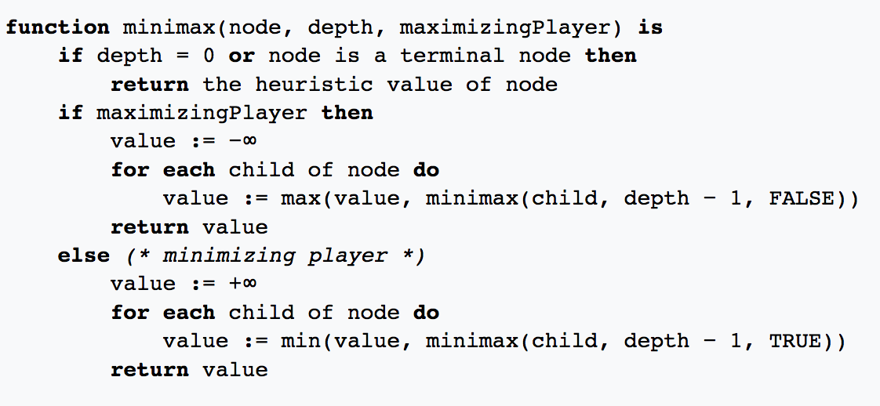
AI AND GAMES
Minimax

Slide 17
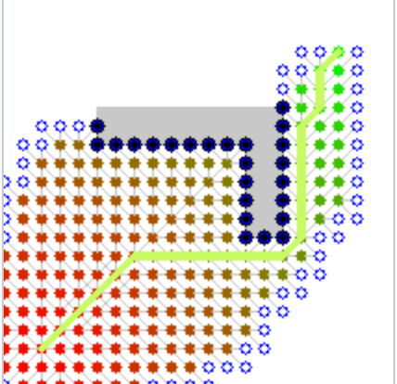
AI AND SEARCH A* ALGORITHM

Slide 18
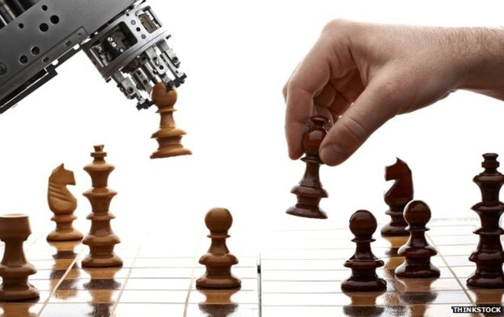

Slide 19
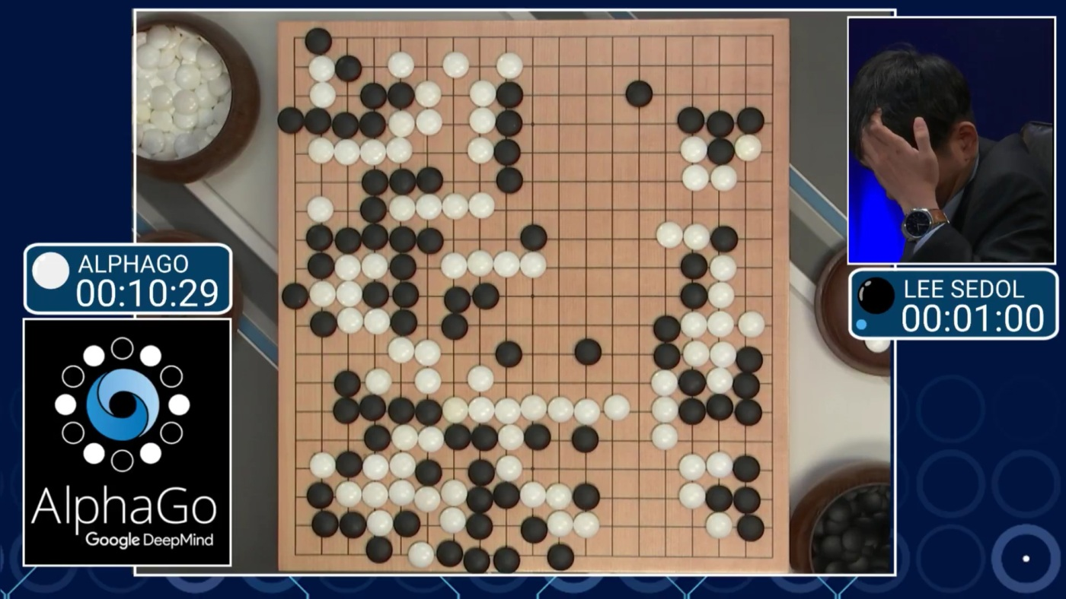

Slide 20
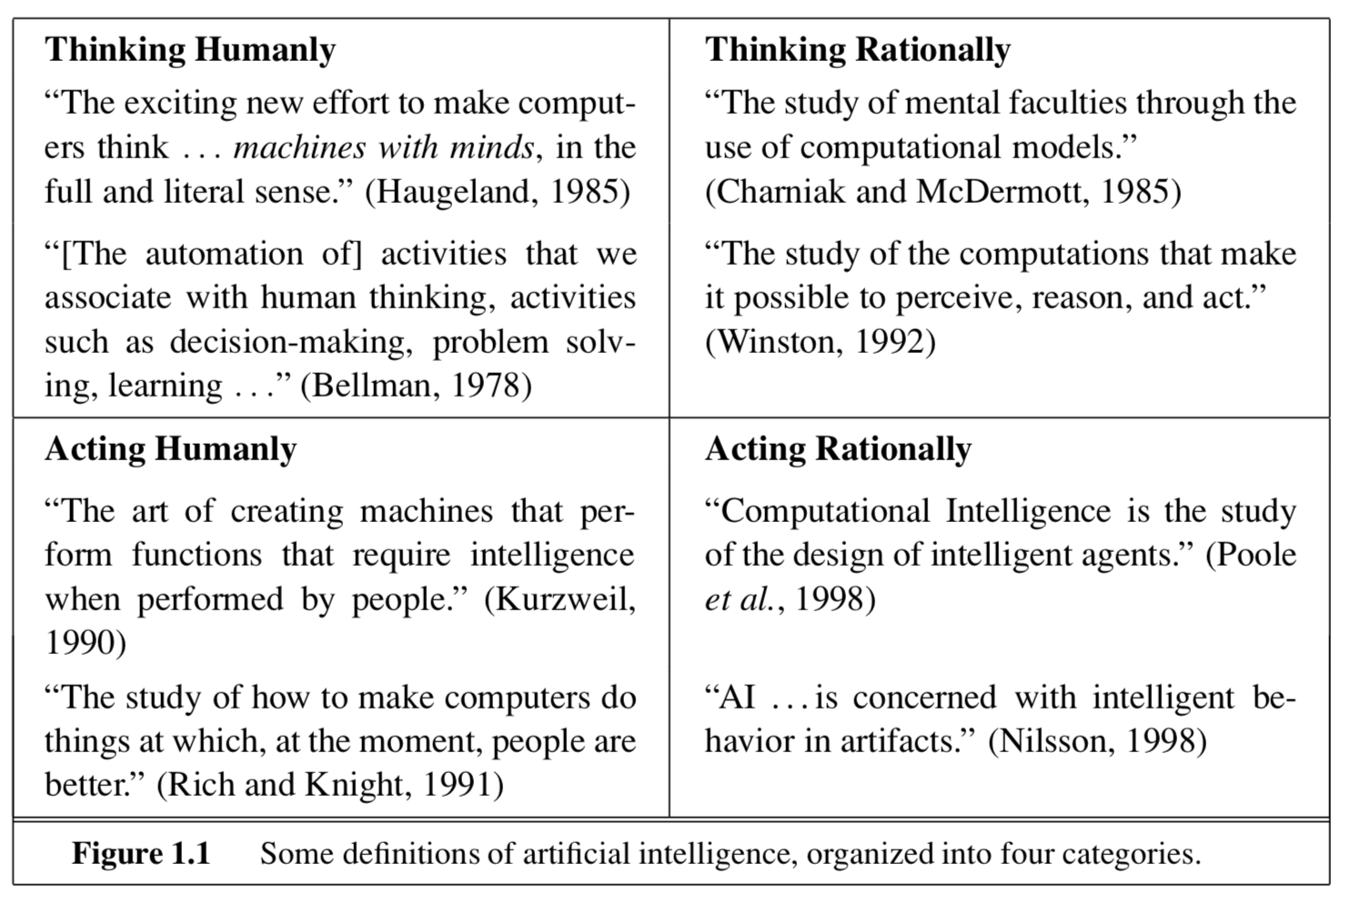

Slide 21
What is artificial Intelligence 什么是人工智能？
Artificial intelligence (AI), sometimes called machine intelligence, is intelligence demonstrated by machines in contrast to the natural intelligence displayed by humans and other animals
人工智能（英语：artificial intelligence，缩写为 AI）亦称机器智能，指由人制造出來的机器所表现出来的智能。通常人工智能是指通过普通电脑程式的手段实现的人类智能技术。

Slide 22
The theory and development of computer systems able to perform tasks that normally require human intelligence, such as visual perception, speech recognition, decision-making, and translation between languages.

Slide 23
What is Data Science 什么是数据科学
Data science is an interdisciplinary field that uses scientific methods, processes, algorithms and systems to extract knowledge and insights from data in various forms, both structured and unstructured, similar to data mining.

Slide 24
1.Interdisciplinary
跨学科
2.extract knowledge and insights from data in various form
从各式数据中提取信息

Slide 25
Relation between artificial intelligence and data science 人工智能和数据科学的关系

Slide 26
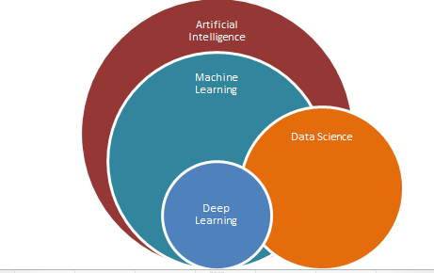

Slide 27
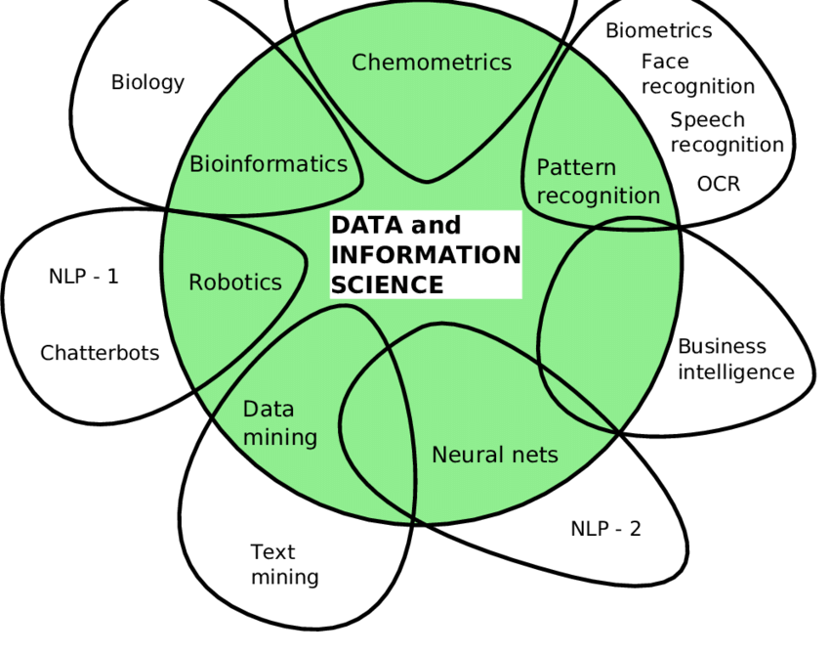

Slide 28
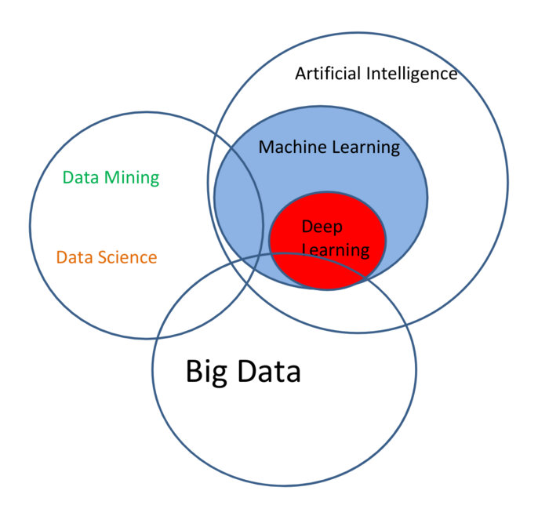

Slide 29
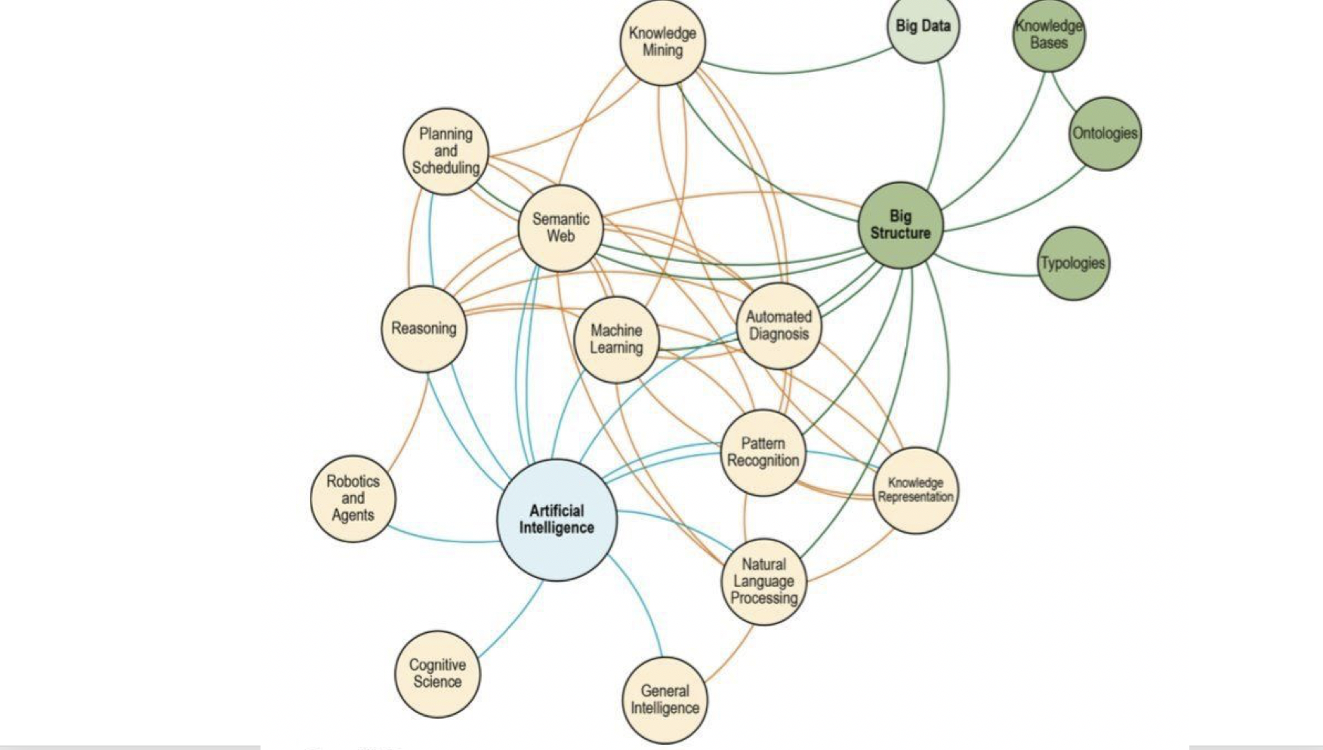

Slide 30
Machine Learning 机器学习
Text Retrieval 文本检索
Data Mining 数据挖掘
Recommender System 推荐系统
Reinforcement Learning 强化学习
DEEP LEARNING AND NEURAL NETWORK 深度学习和神经网络

Slide 31
MACHINE LEARNING 机器学习

Slide 32
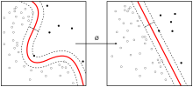
What is machine learning 什么是机器学习
Machine learning is a subset of artificial intelligence in the field of computer science that often uses statistical techniques to give computers the ability to “learn” (i.e., progressively improve performance on a specific task) with data, without being explicitly programmed.
---wikipedia

Slide 34
机器学习和人工智能的关系： 机器学习是实现人工智能的方法

Slide 35
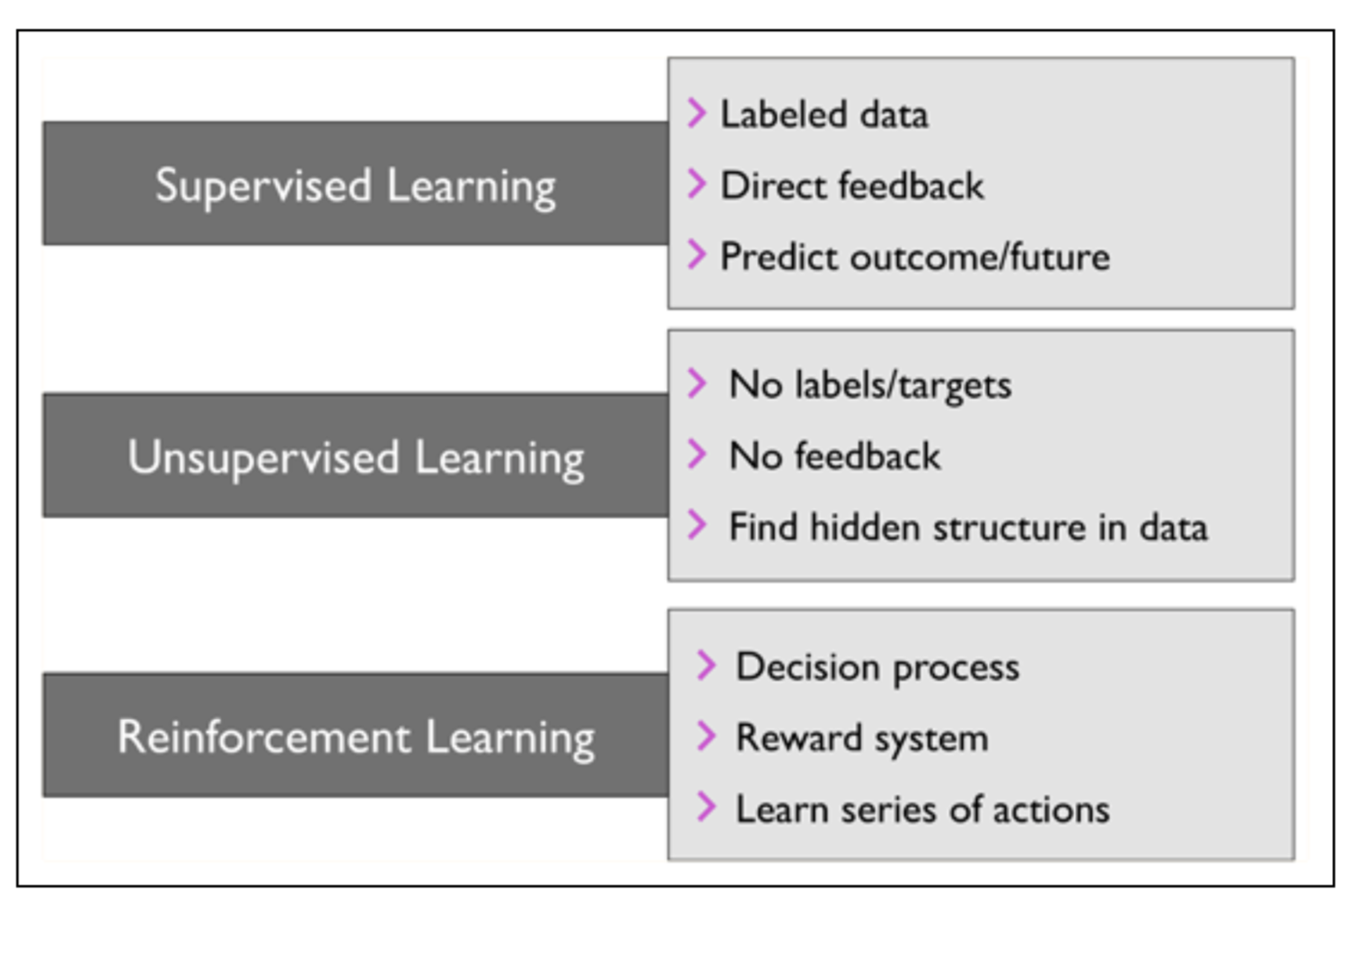

Slide 36
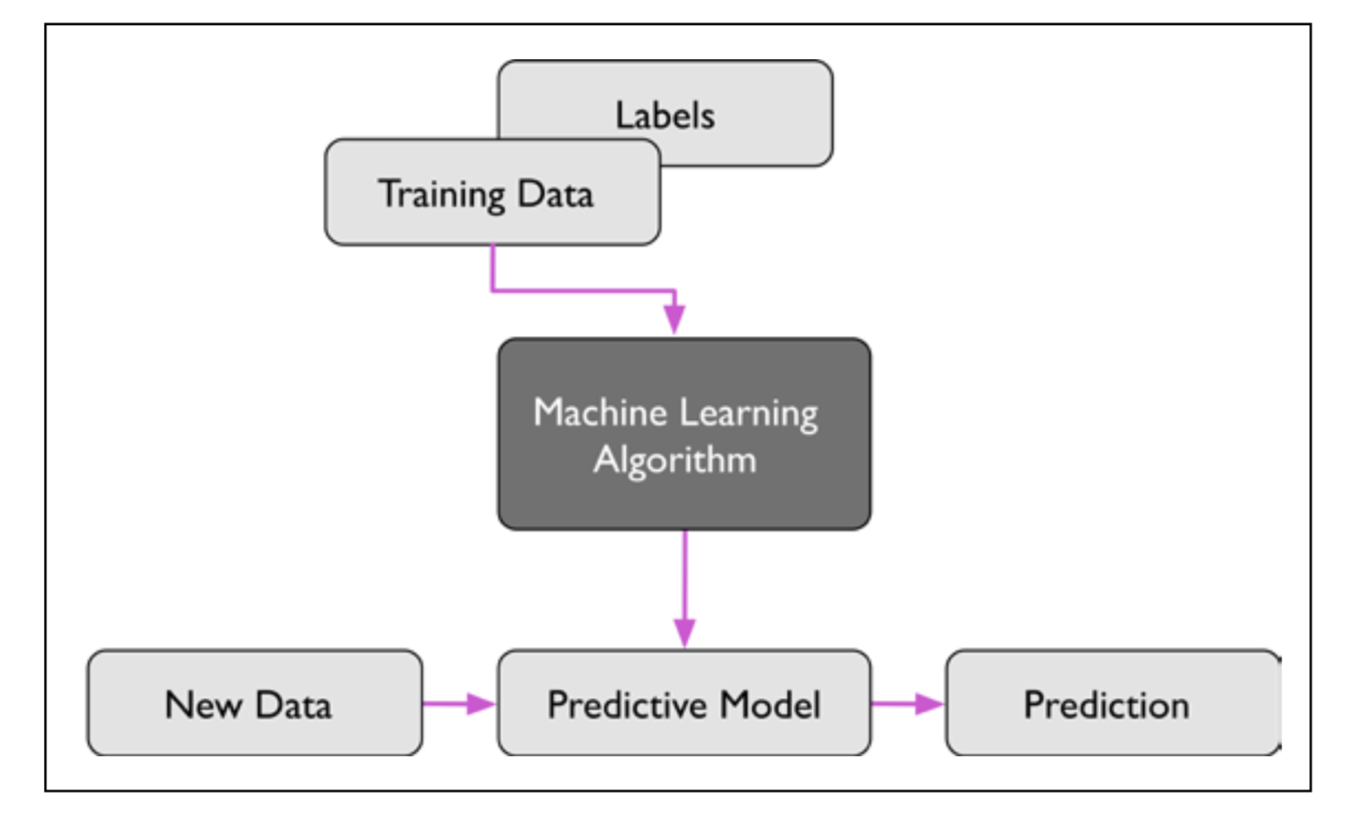
supervised learning 监督学习

Slide 37
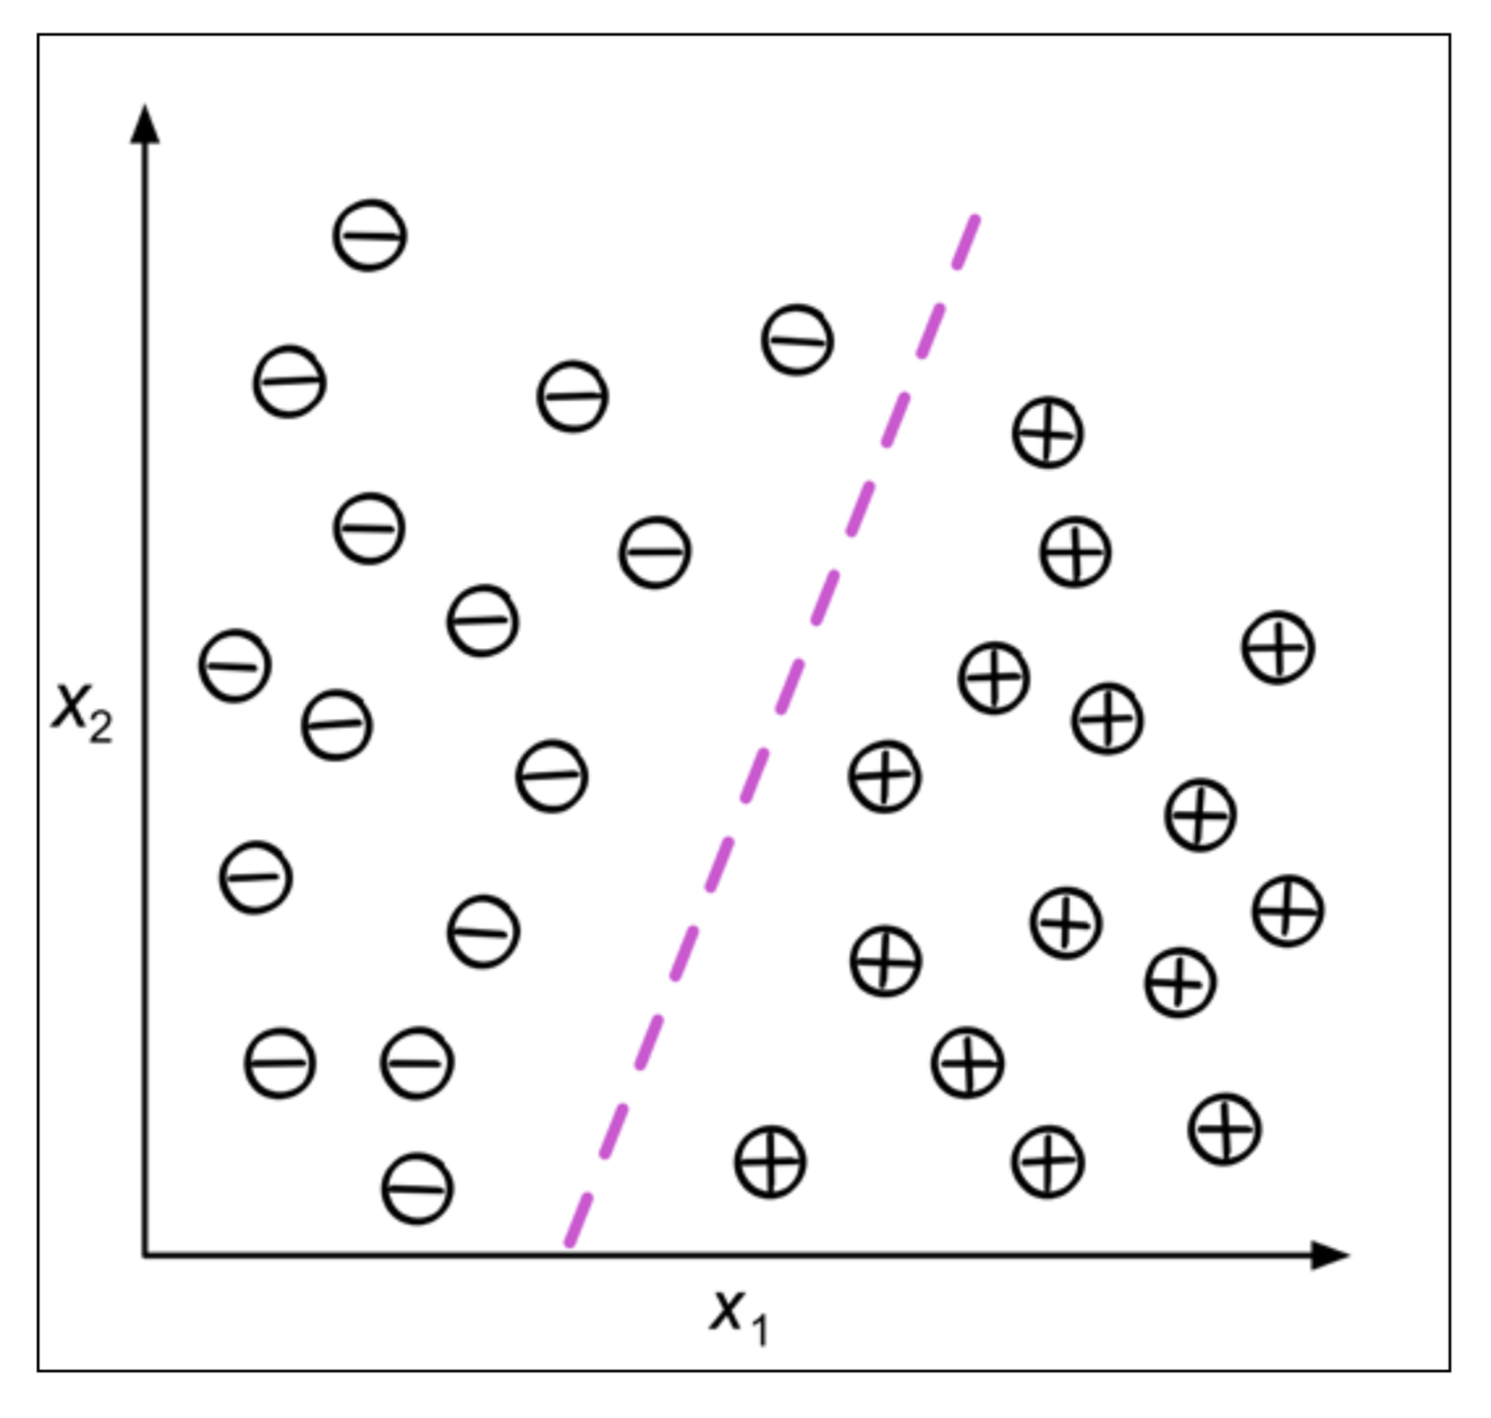

Slide 38
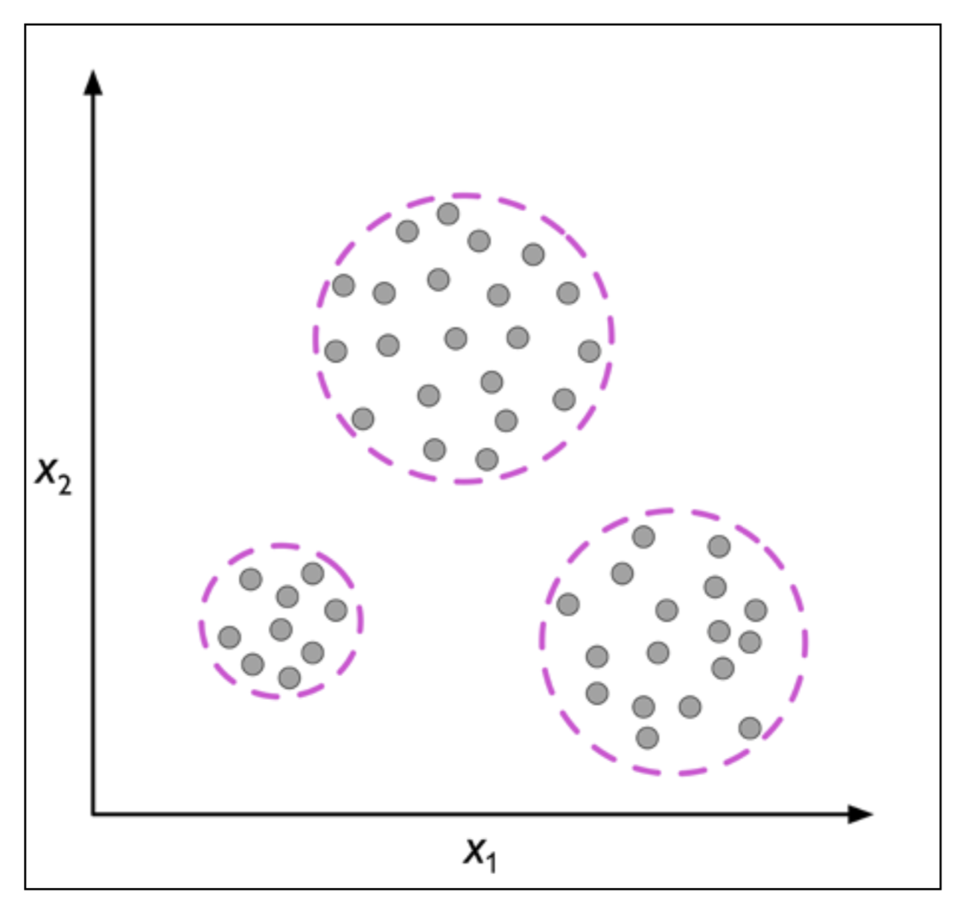
Unsupervised learning 非监督学习

Slide 39
Machine learning Python demo

Slide 40
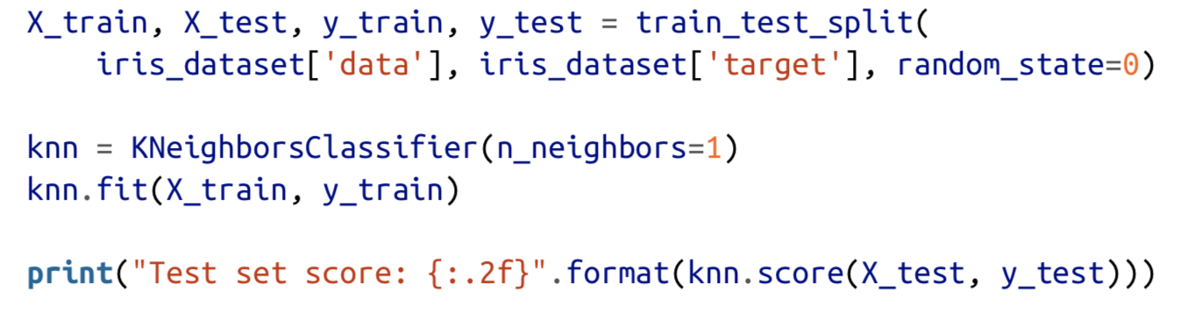

Slide 41
K-NEAREST NEIGHBORS

Slide 42
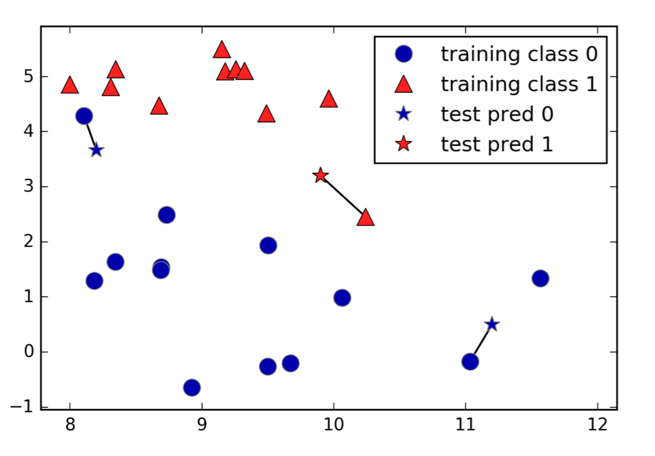

Slide 43
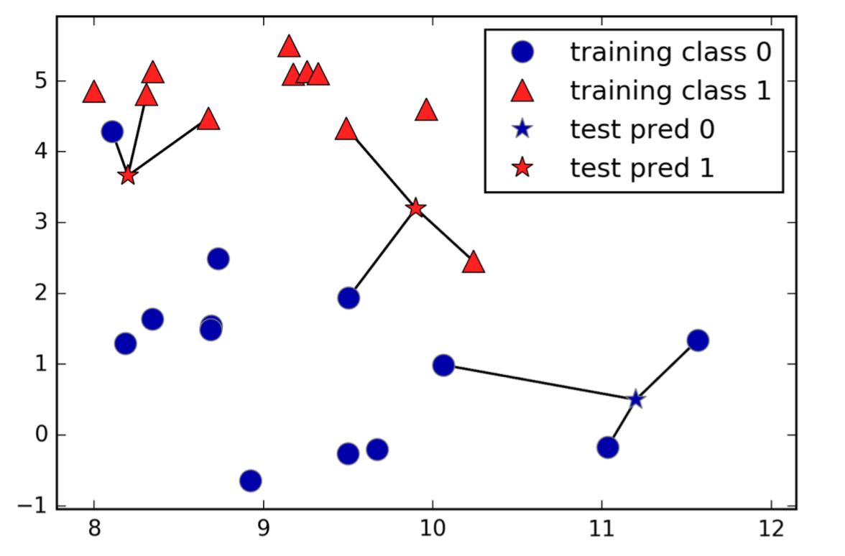

Slide 44
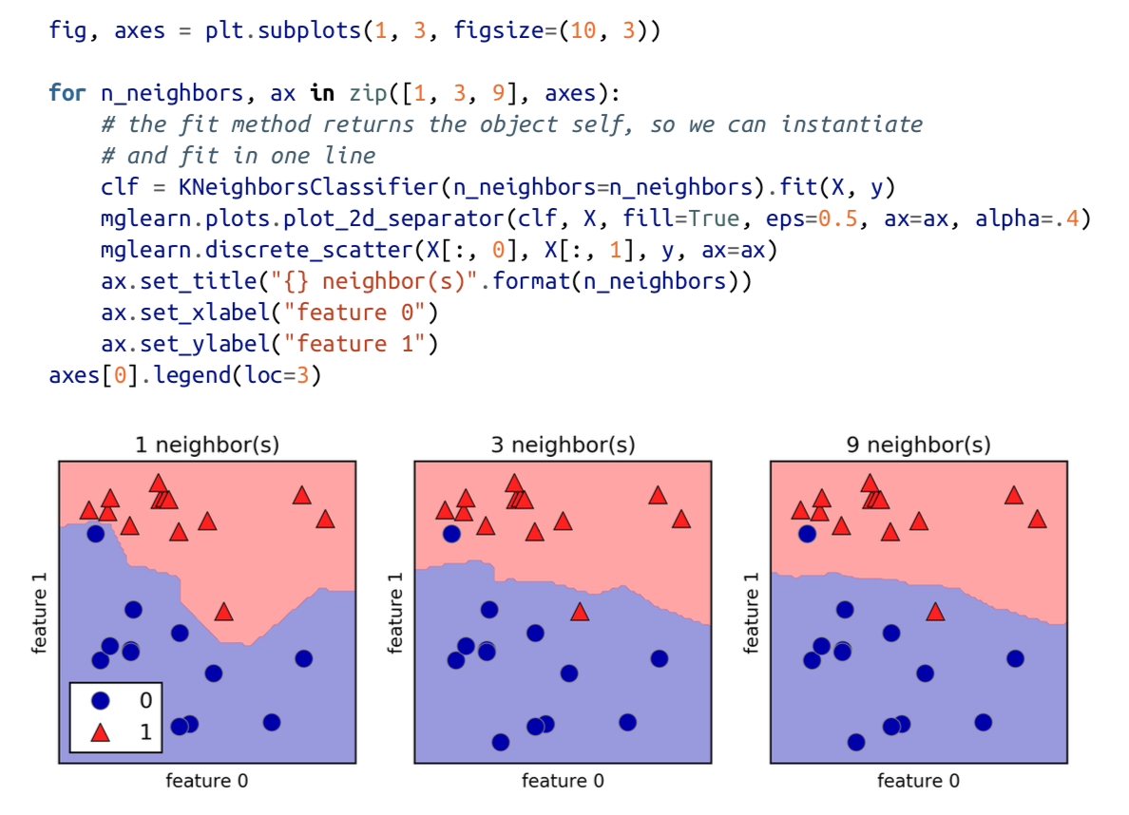

Slide 45
Linear Models

Slide 46
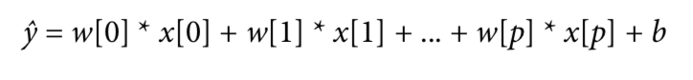
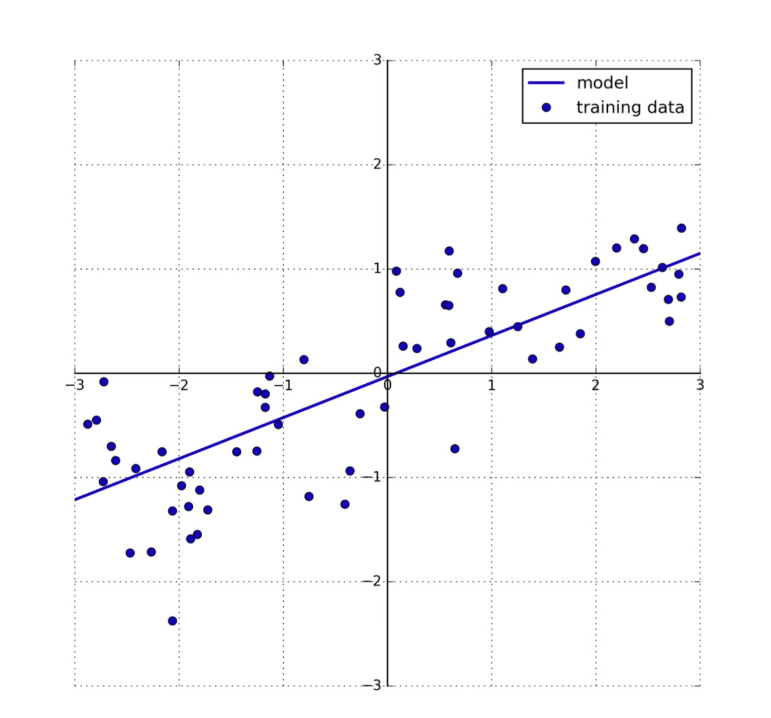

Slide 47
Naive Bayes 朴素贝叶斯

Slide 48
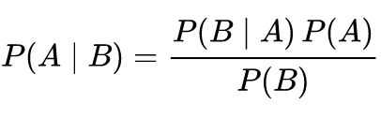
Bayes' theorem

Slide 49
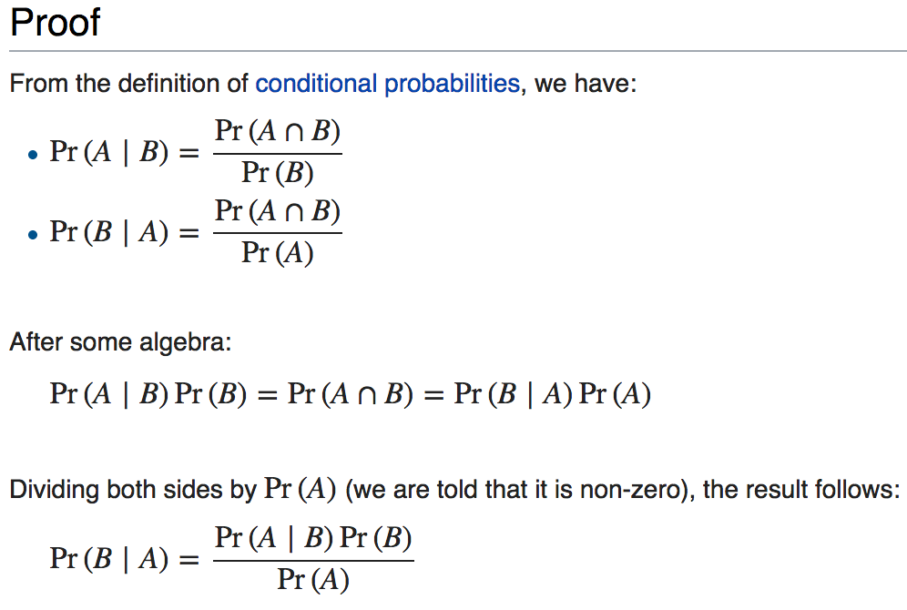

Slide 50
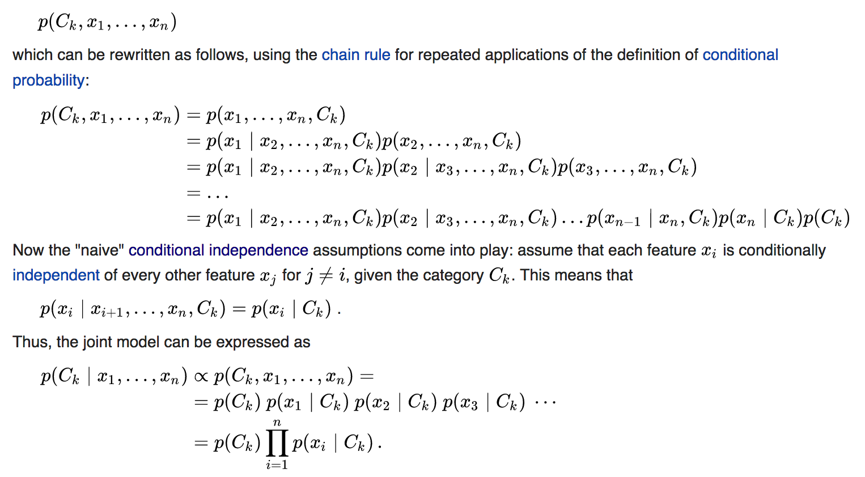

Slide 51
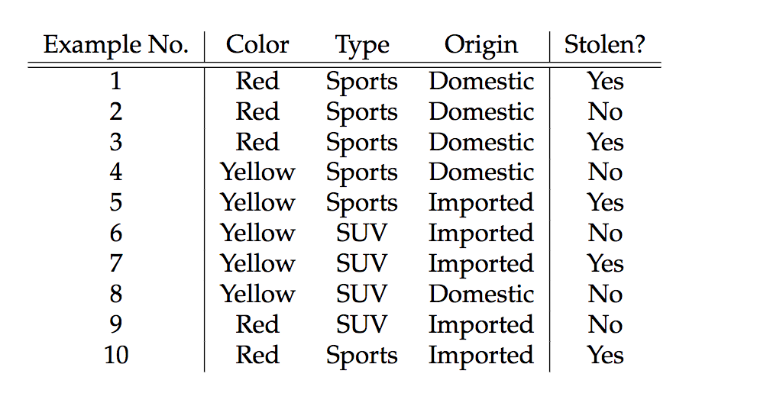

Slide 52
What we want

Slide 53
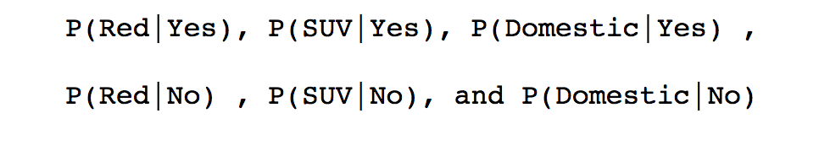
WHAT WE NEED

Slide 54
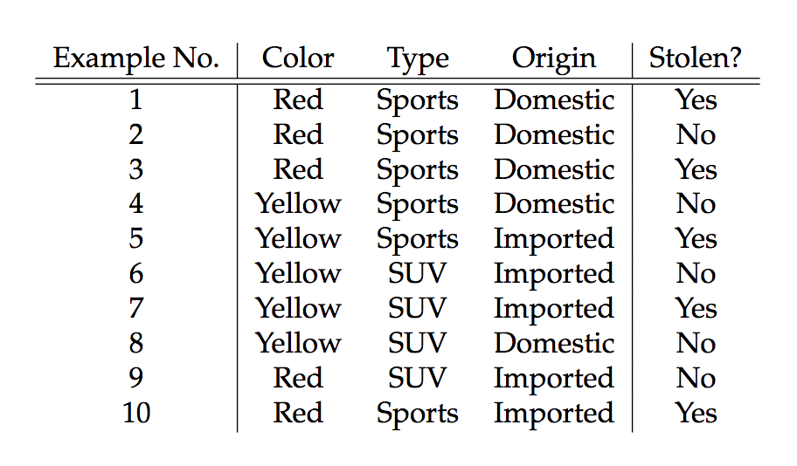
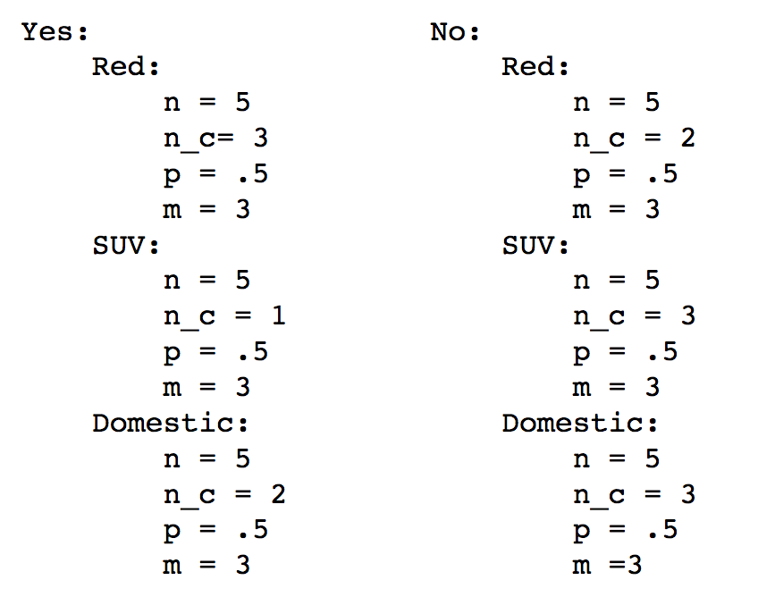

Slide 55
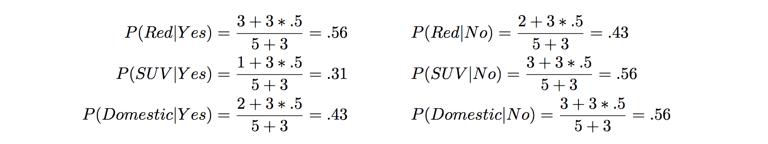

Slide 56
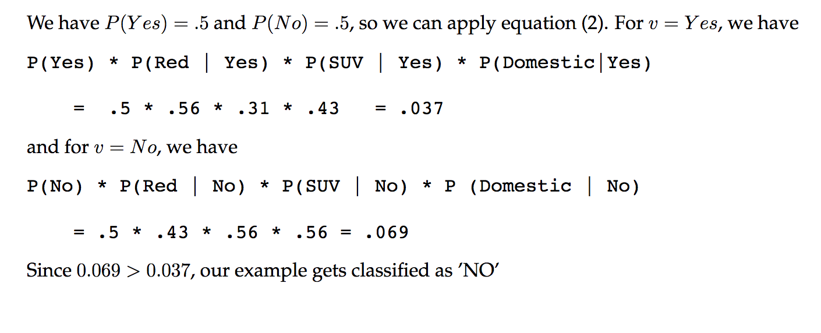

Slide 57
Decision trees 决策树

Slide 58
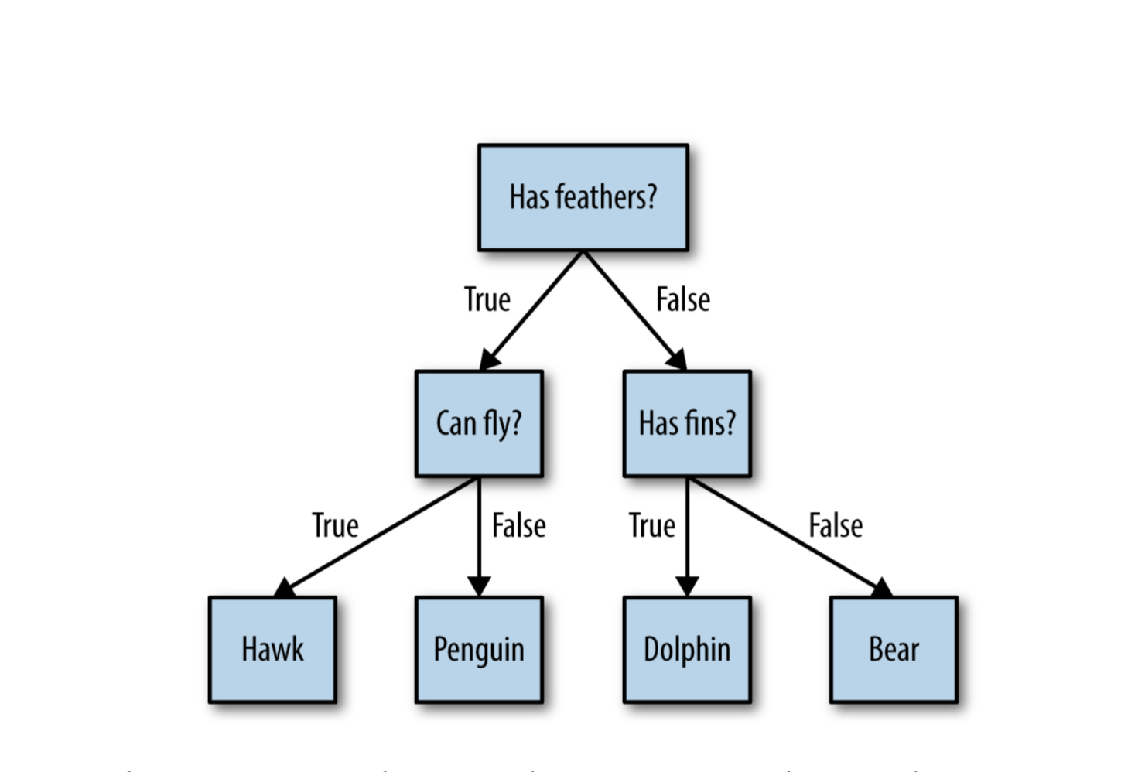

Slide 59
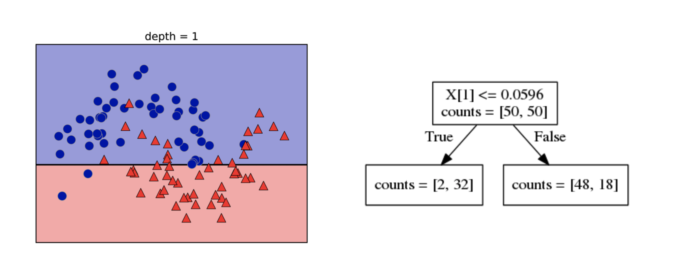

Slide 60
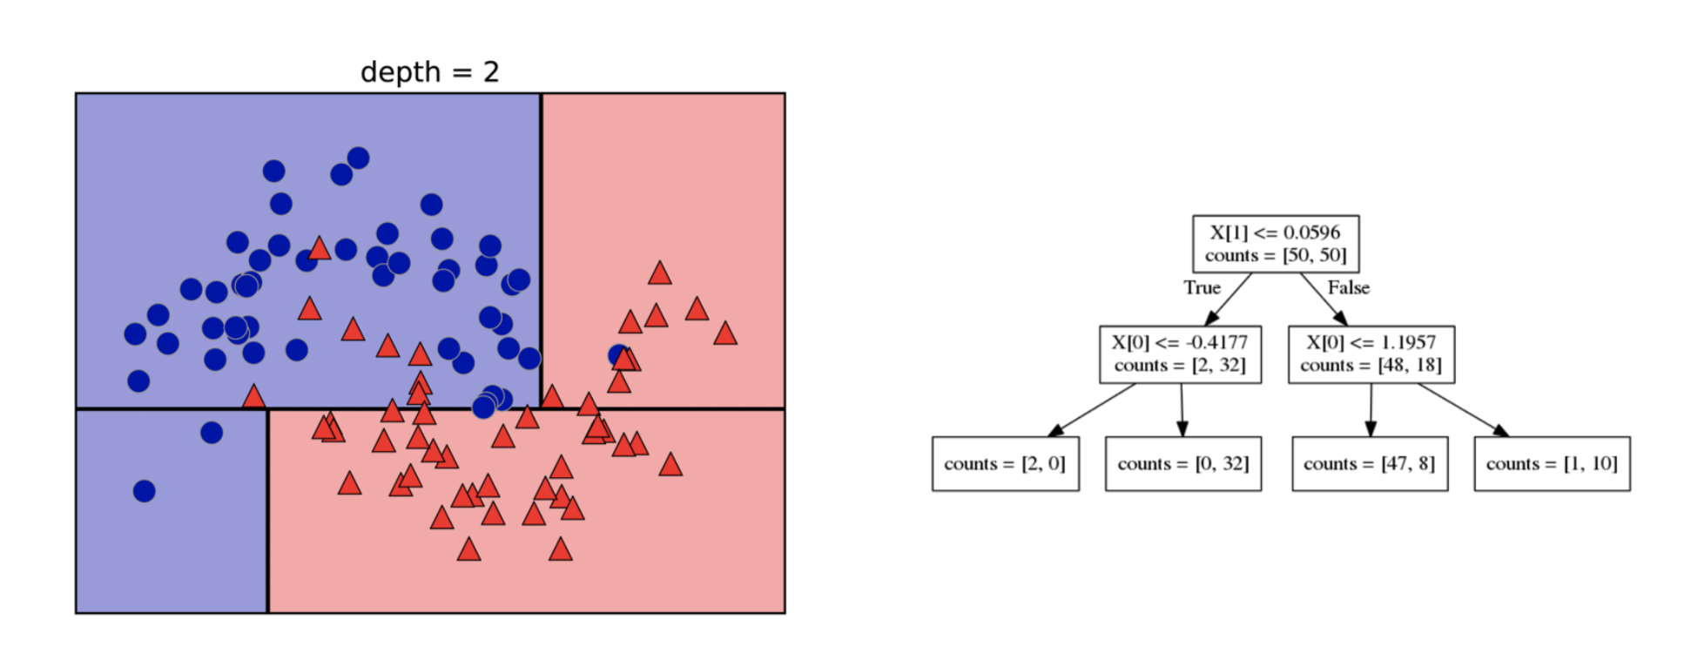

Slide 61
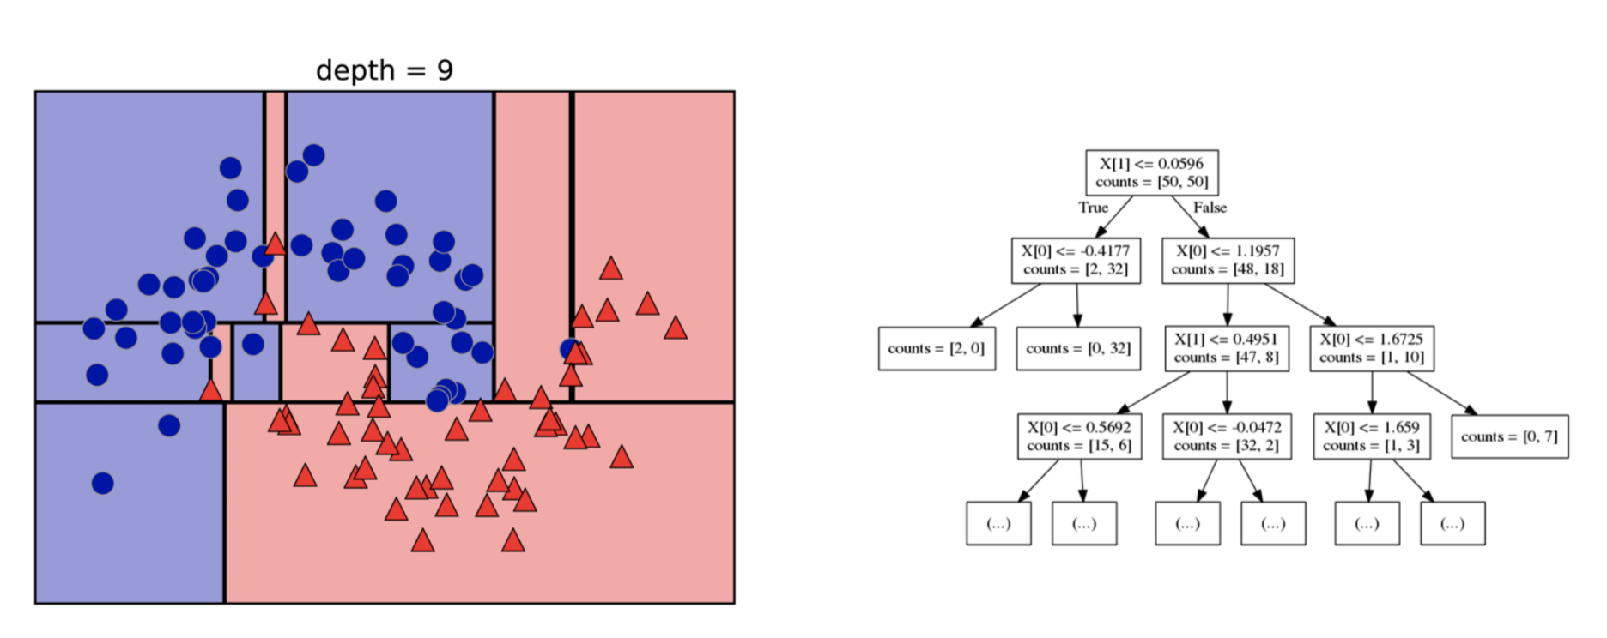

Slide 62
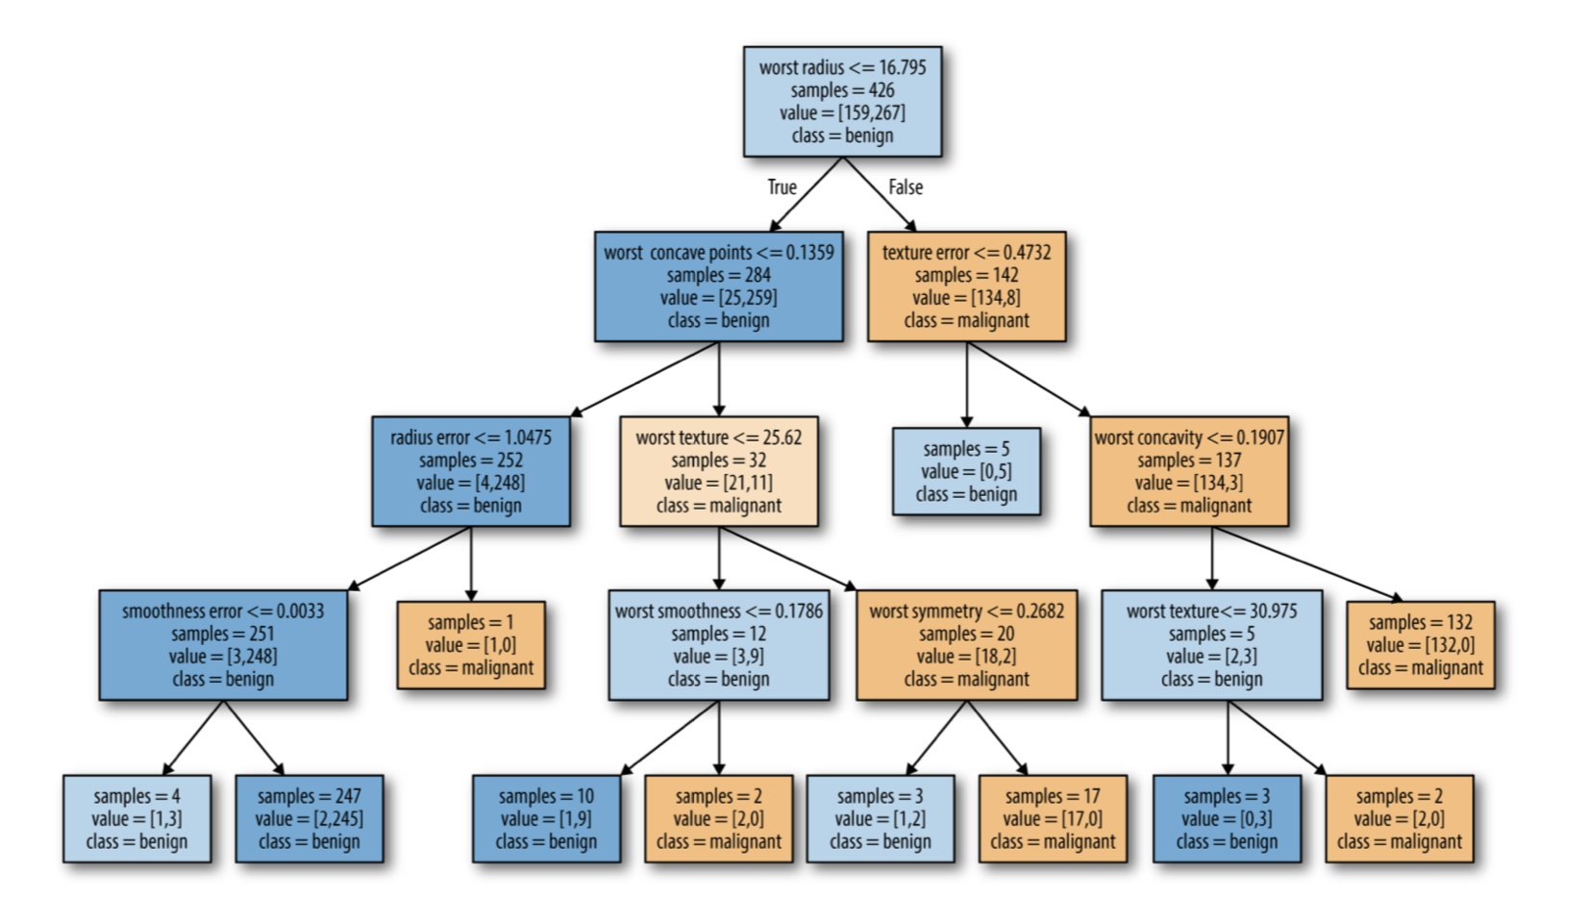

Slide 63
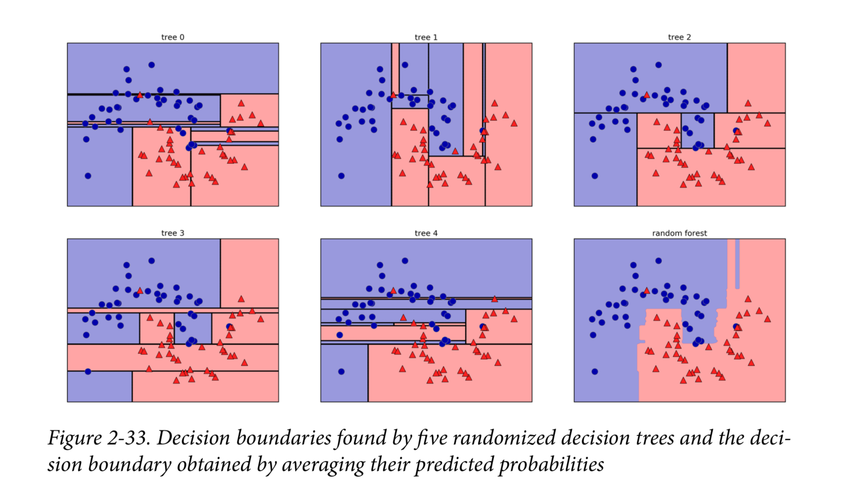
RANDOM FORESTS

Slide 64
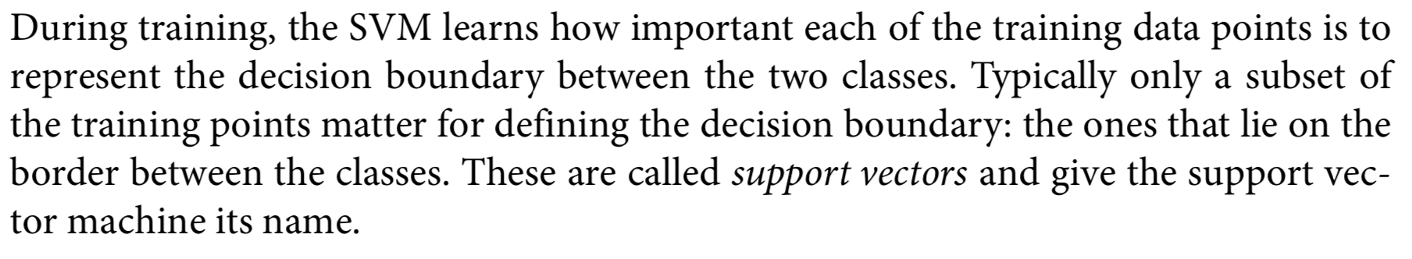
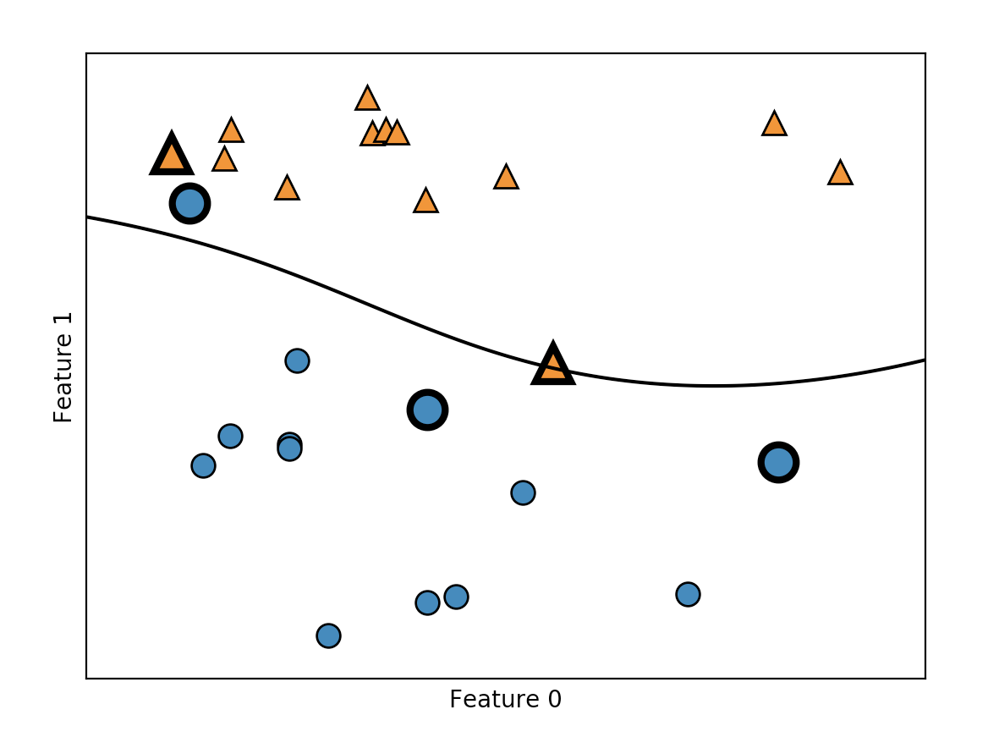
SVM

Slide 65

Linear support vector machine

Slide 66


Slide 67


Slide 68


Slide 69
More Python Demo and Data Visualization

Slide 70
Why Python?
Python has become the lingua franca for many data science applications. It combines the power of general-purpose programming languages with the ease of use of domain-specific scripting languages like MATLAB or R. Python has libraries for data loading, visualization, statistics, natural language processing, image processing, and more. This vast toolbox provides data scientists with a large array of general- and special-purpose functionality. One of the main advantages of using Python is the ability to interact directly with the code, using a terminal or other tools like the Jupyter Notebook, which we’ll look at shortly. Machine learning and data analysis are funda‐ mentally iterative processes, in which the data drives the analysis. It is essential for these processes to have tools that allow quick iteration and easy interaction.

Slide 71
What you might need
sklearn
numpy
scipy
matplotlib
pandas

Slide 72


numpy

Slide 73


Slide 74


pandas

Slide 75


matplotlib

Slide 76
Text retrieval 文本检索

Slide 77
Why
Text (natural language) is the most natural way of encoding human knowledge. （自然）
Text is by far the most common type of information encountered by people. （常见）
Text is the most expressive form of information （直观）

Slide 78
Vector Space Retrieval Model

Slide 79

Bit Vector Representation
1: 关键字存在 0: 关键字不存在

Slide 80

出现的问题：d2==d3==d4

Slide 81

加入关键词出现的频率

Slide 82
出现的问题：d2==d3

Slide 83

加入idf ：（inverse document frequency ）
M : 所有文件的数量
df(.) : 存在关键字的文档数量

Slide 84
Penalize common words which generally have a low IDF and reward informative words that have a higher IDF
惩罚IDF值低的字，奖励IDF值高的字

Slide 85


Slide 86


Slide 87

新的问题：d5相关性不大却得到了很高的值

Slide 88

A ranking function
c(w, q) the count of the query term w in the query
c(w, d) the count of w in the document

Slide 89


Slide 90
Probabilistic Retrieval Models

Slide 91


Slide 92
Data mining 数据挖掘

Slide 93
Interdisciplinary subject
Knowledge discovery from data

Slide 94
Difference between data mining and information retrieval

Slide 95
Information retrieval (IR) is the science of searching for documents or information in documents. Documents can be text or multimedia, and may reside on the Web. The differences between traditional information retrieval and database systems are twofold: Information retrieval assumes that (1) the data under search are unstructured; and (2) the queries are formed mainly by keywords, which do not have complex structures (unlike SQL queries in database systems).

Slide 96
1. Data cleaning (to remove noise and inconsistent data)（清理）

Slide 97
2. Data integration (where multiple data sources may be combined)（合并）

Slide 98
3. Data selection (where data relevant to the analysis task are retrieved from the database) （选取）

Slide 99
4.Data transformation (where data are transformed and consolidated into forms appropriate for mining by performing summary or aggregation operations)
（转化）

Slide 100
5.Data mining (an essential process where intelligent methods are applied to extract data patterns) （挖掘）

Slide 101
6.Pattern evaluation (to identify the truly interesting patterns representing knowledge based on interestingness measures.（评估）

Slide 102
7.Knowledge presentation (where visualization and knowledge representation techniques are used to present mined knowledge to users) （生成结果）

Slide 103


Slide 104
STATISTICAL CONCEPTS YOU NEED TO KNOW

Slide 105
Mean

Slide 106
Median

Slide 107
Mode

Slide 108
range

Slide 109

Variance and standard deviation

Slide 110


Slide 111


Slide 112


Slide 113


Slide 114


Slide 115
IGNORE THE TUPLE（忽略数据）
This is usually done when the class label is missing (assuming the mining task involves classification). This method is not very effective, unless the tuple contains several attributes with missing values. It is especially poor when the percent- age of missing values per attribute varies considerably. By ignoring the tuple, we do not make use of the remaining attributes’ values in the tuple. Such data could have been useful to the task at hand.
（可能导致某些特征被忽略）

Slide 116
Fill in the missing value manually （手动填充）
In general, this approach is time consuming and may not be feasible given a large data set with many missing values. （丢失数据量过大时不可行）

Slide 117
Use a global constant to fill in the missing value (加入全局变量)
Replace all missing attribute values by the same constant such as a label like “Unknown” or −∞. If missing values are replaced by, say, “Unknown,” then the mining program may mistakenly think that they form an interesting concept, since they all have a value in common—that of “Unknown.” Hence, although this method is simple, it is not foolproof （可能导致该变量变成特征）

Slide 118
Use a measure of central tendency for the attribute (e.g., the mean or median) to fill in the missing value （平均数或中位数替换）
For normal (symmetric) data distributions, the mean can be used, while skewed data distribution should employ the median

Slide 119
Use the most probable value to fill in the missing value （用可能性最高的替换）
This may be determined with regression, inference-based tools using a Bayesian formalism, or decision tree induction. （应用某些机器学习方法）

Slide 120
Data Reduction

Slide 121
1. Stepwise forward selection: The procedure starts with an empty set of attributes as the reduced set. The best of the original attributes is determined and added to the reduced set. At each subsequent iteration or step, the best of the remaining original attributes is added to the set. （选取最好的）

Slide 122
2. Stepwise backward elimination: The procedure starts with the full set of attributes. At each step, it removes the worst attribute remaining in the set. （移除最差的）

Slide 123
3. Combination of forward selection and backward elimination: The stepwise for- ward selection and backward elimination methods can be combined so that, at each step, the procedure selects the best attribute and removes the worst from among the remaining attributes. （二者合并）

Slide 124
4. Decision tree induction: Decision tree algorithms (e.g., ID3, C4.5, and CART) were originally intended for classification. Decision tree induction constructs a flowchart- like structure where each internal (nonleaf) node denotes a test on an attribute, each branch corresponds to an outcome of the test, and each external (leaf) node denotes a class prediction. At each node, the algorithm chooses the “best” attribute to partition the data into individual classes.

Slide 125
Recommender system 推荐系统

Slide 126
内容过滤(content based filtering)
协同过滤(collaborative filtering)

Slide 127
内容过滤：
根据个人喜好进行推荐

Slide 128
协同过滤：
根据其他用户进行推荐
假定条件：
具有相同爱好的用户喜好相近
喜好相近的用户具有相同的兴趣

Slide 129
A -> 1112121111173911
1 -> A
B == A
B -> 2
2 -> A

Slide 130


Slide 131
举例：今日头条

Slide 132


Slide 133


Slide 134


Slide 135
Reinforcement learning 强化学习

Slide 136
强化学习是机器学习中的一个领域，强调如何基于环境而行动，以取得最大化的预期利益。
---维基百科

Slide 137

State and Action

Slide 138


Slide 139
举例：q learning

Slide 140


Slide 141

目标 : 5

Slide 142

将到达5的行为奖励100

Slide 143


Slide 144


Create a reward table

Slide 145
-1：不存在
0：无奖励
100： 奖励

Slide 146

Initial state：1
Action : 3 or 5
Random：5

Slide 147



Slide 148




Slide 149
Since 5 is the goal state, this episode is finished.
（到的目的地，从新开始新一轮学习）

Slide 150


Slide 151


Slide 152


Slide 153
DEEP LEARNING AND NEURAL NETWORK
深度学习和神经网络

Slide 154

logistic regression

Slide 155


Slide 156


Slide 157


Slide 158


Slide 159


A bounded decision function (Linear)
or

Slide 160


The decision function h :
(sigmoid function)

Slide 161

We need h to be bounded between 0 and 1

Slide 162

Our Data:

Slide 163


We want to minimize:

Slide 164

We choose to use gradient descent method for optimization

Slide 165


Gradient descent:
We choose to use gradient descent method for optimization

Slide 166



Chain rule:

Slide 167


Slide 168

After applying similar steps, we can get:

Slide 169


Slide 170


Slide 171

Limitation

Slide 172

How to Solve this ?

Slide 173


Slide 174



Slide 175


Slide 176
Some texts and images are from the following:
Artificial Intelligence A Modern Approach Third Edition - Stuart J. Russell and Peter Norvig
Text Management and Analysis A Practical Introduction to Information Retrieval and Text Mining - ChengXiang Zhai
Data Mining Concepts and Techniques Third Edition -Jiawei Han
Introduction to Machine Learning with Python A Guide for Data Scientists - Andreas C. Müller and Sarah Guido
Deep Learning - Ian Goodfellow Yoshua Bengio and Aaron Courville

Slide 177
where to find this ppt:
www.github.com/ChongyeWang/Artificial-Intelligence-and-Data-Science

Slide 178
Thanks!

